Slide 1
Chapter1 Introduction to Data Structure
Prof.Mrunal Fatangare
Department of Computer Engineering
School of Polytechnic & Skill Development

Slide 2
Course Outcome
CO1: To gain knowledge of Various types of Data Structure

Slide 3
Learning Outcomes
TLO 1.1 Classify the given type of Data Structures based on their characteristics and space.
TLO 1.2 Perform operations on the given type of Data Structure.
TLO 1.3 Describe the concept of time and space complexity
TLO 1.4 Implement various string functions

Slide 4
What will we Learn
1.1 Introduction: Concept and Need of Data Structure, Definition, Abstract Data Type
1.2 Types of Data Structures: (i) Linear Data Structures (ii) Non-Linear Data Structures
1.3 Operations on Data Structures: (i) Traversing (ii) Insertion (iii) Deletion
1.4 Control Structures used in Algorithms, Analysis of algorithms, Time and Space Complexity-Worst Case, Average Case, Best Case and Amortized String functions.
1.5 Bitwise Operators -1, Bitwise Operators- 2, Bit Manipulation using Bitwise Operators-1, Bit Manipulation using Bitwise Operators-2

Slide 5
The Need for Data Structures
A data structure is a specialized format designed to organize, manage, process, and store data in a computer's memory so it can be accessed and modified efficiently. It acts as a logical blueprint that defines the relationship between data elements and the permissible operations that can be performed on them
Data management
data collection
organization of data into appropriate structures
developing and maintaining routines for quality assurance.

Slide 6
The Need for Data Structures
Data structure
One name
Particular way of storing and organizing data
Efficient use
More efficient programmes
Complex operations
More calculations within less time and energy

Slide 7
Applications
Compiler design
Operating system
Statistical analysis package
DBMS
Numerical analysis
Simulation
Artificial intelligence
Graphics

Slide 8
Need of Organization
Data organization is the process of structuring, categorising, and managing raw facts so they are easily accessible, understandable, and analyzable. It is essential for eliminating the confusion of raw numbers, allowing you to extract actionable insights, spot trends, and make informed decisions efficiently.
The fundamental needs and benefits of data organization include:
Time-Saving Retrieval: As datasets grow, finding specific information in unorganized records wastes significant time. Organizing data systematically allows for rapid searches and quick filtering.
Enhanced Decision-Making: Clear, structured data (like grouped frequency distributions or charts) reveals patterns and relationships that raw, unstructured observations conceal.
Improved Accuracy: Organizing data upfront using consistent naming, standardized categories, and version control reduces inconsistencies and costly human errors.
Streamlined Collaboration: Consistent formatting and clear documentation ensure teams and researchers can easily share, interpret, and build upon the same information.
Better Visualization: Well-organized data is much easier to translate into effective visual aids like bar graphs, pie charts, and dashboards.

Slide 9
Selecting A Data Structure
Select a data structure as follows
Analyze the problem to determine the resource constraints a solution must meet.
Determine basic operations that must be supported.
Select the data structure that best meets these requirements.

Slide 10
Data Structure Philosophy
Each data structure has costs and benefits.
Rarely is one data structure better than another in all situations.
A data structure requires:
space for each data item it stores,
time to perform each basic operation,
programming effort.
Each problem has constraints on available time and space.

Slide 11
Definitions
A type is a set of values.
E.g., boolean, int
Can be an infinite set (but not on a computer)
A data type is a type and a collection of operations that manipulate the type.
A data element or element is a piece of information in a record.
A simple data item contains no subparts.
An aggregate data item may contain several pieces of information.
Record – collection of data items
File – Collection of records

Slide 12
Abstract Data Types
Abstract Data Type (ADT): a definition for a data type solely in terms of a set of values and a set of operations on that data type.
An Abstract Data Type (ADT) is a conceptual model that defines a data type solely by its behaviour and the operations that can be performed on it, completely independent of its underlying implementation. It serves as a contract or "blueprint" that tells you what the data type does, but not how it does it.
Properties:
Abstraction: Hides complex, low-level details behind a simpler, high-level interface.
Encapsulation: Bundles the data and its valid operations together into a single conceptual unit.
Data Independence: You can swap the internal implementation (e.g., switching from an array to a linked list) without breaking any external code that uses the ADT
Examples:
Stack, Queue, List, Map / Dictionary, Set

Slide 13
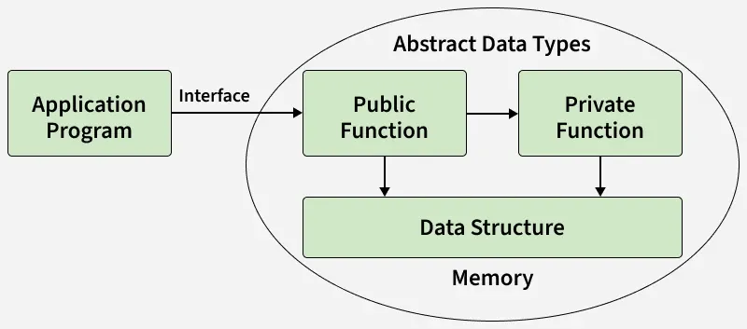
Difference between ADT and Data Structure
Feature | Abstract Data Type (ADT) | Data Structure
Perspective | User's view: Focuses on the logical behavior and operations. | Implementer's view: Focuses on memory organization and code.
Nature | Theoretical and conceptual. | Concrete and physical.
Language Feature | Represented by Interfaces or Abstract Classes. | Represented by Classes, Structs, or Arrays.
Example | Stack (supports push and pop). | Linked List or Array (used to build the stack).

Slide 14
Difference between ADT and UDT
Feature | Abstract Data Types (ADTs) | User-Defined Data Types (UDTs)
Definition | Defines the logical behavior of a data type without specifying its implementation. | Defines custom data types created by programmers using programming language constructs.
Focus | Focuses on allowed operations and their behavior, without implementation details. | Focuses on how data is organized in memory and how operations are executed.
Purpose | Provides an abstract model for defining data structures conceptually. | Allows programmers to create concrete implementations of data structures using primitive types.
Implementation | Does not define the implementation of operations or data structure. | Specifies how to create and organize data types for implementing the structure.
Examples | List, Stack, Queue | Classes, Structs, Enumerations

Slide 15
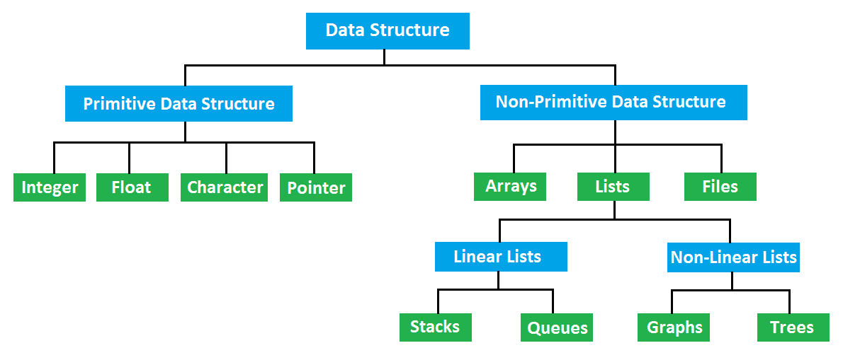
Classification

Slide 16
Classification
Ephemeral data structures are traditional, mutable structures where modifying the data (such as an insert, delete, or update) destroys the previous version. Once an update occurs, only the latest state of the structure is accessible, making them ideal for high performance in imperative programming
Common Examples
Almost all foundational data structures in traditional imperative programming languages (like C, Java, or C++) are ephemeral by default.
Arrays
Linked Lists
Standard Queues and Stacks
Hash Table

Slide 17
Classification
A persistent data structure is a specialized data structure that always preserves its previous versions when modified, making them effectively immutable. Instead of updating data in-place like standard (ephemeral) structures, updates yield a new version while keeping the old version fully intact and accessible
Persistence is categorized by how historical versions can be accessed or modified
Partial Persistence: All historical versions can be queried, but only the newest version can be modified. The history forms a linear timeline.
Full Persistence: Every historical version can be both queried and modified. Modifying an older version creates a new branch, changing the history layout into a version tree.
Confluent Persistence: Historical versions can be queried, modified, and merged to form a new version.
Common Techniques:
Path Copying
Node-Copying

Slide 18
Data Structures
Data structures: Organization of data The collection of data you work with in a program have some kind of structure or organization.
No matter how complex your data structures are they can be broken down into two fundamental types:
Contiguous
Non-Contiguous.

Slide 19
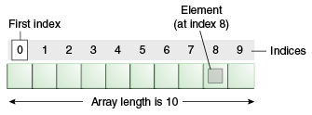
Array Representation
Arrays - store a fixed-size sequential collection of elements of the same type.
Arrays - collection of variables of the same type.

Slide 20
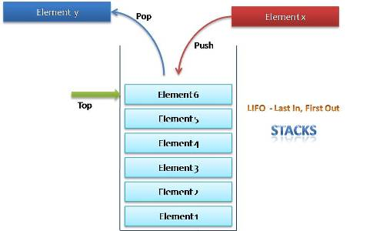
Stack

Slide 21


Stack Example
Text Editor Undo Feature
Web Browser History
The Call Stack:

Slide 22
Queue
A Queue is a linear structure that follows a particular order in which the operations are performed. The order is First In First Out (FIFO).

Slide 23
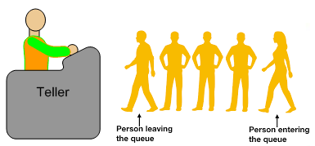
Queue example
Print Spooling
Web Servers

Slide 24
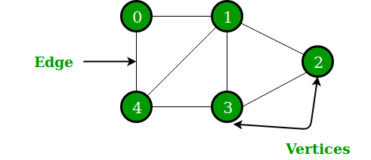
Graphs
1. A finite set of vertices - nodes. 2. A finite set of ordered pair of the form (u, v) - edge.
3. Operations: Create, Insert edge, delete edge, insert node , delete node, find node, traverse graph

Slide 25
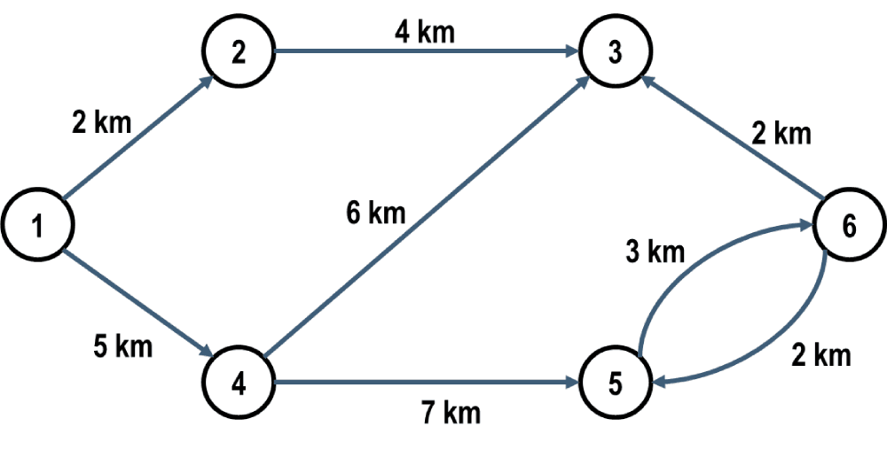
Graph Example
Social Networks (e.g., LinkedIn or Facebook)
Recommendation Engines (e.g., Amazon or Netflix)
Airline Crew Scheduling

Slide 26
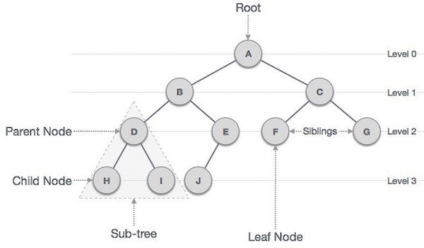

Trees
1. hierarchical data structure.
2. Operations – Search, delete, insert, traverse

Slide 27

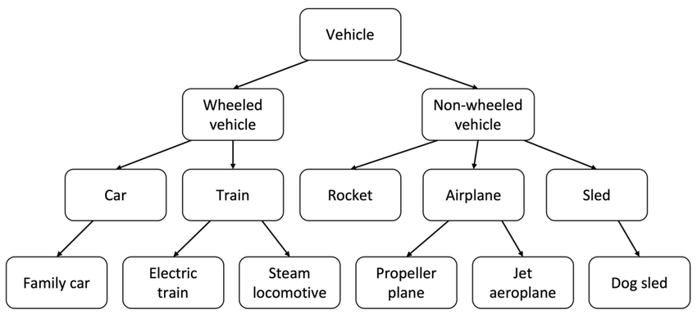
Tree Example
File Systems
Databases (B-Trees and B+ Trees)
Artificial Intelligence (Decision Trees)
Software Compilers (Syntax Trees)

Slide 28
OPERATIONS ON DATA STRUCTURES
Traversing
Searching
Inserting
Deleting
Merging
Sorting

Slide 29
Operations
10
25
17
14
38
Traversing
10
25
17
14
38

Slide 30
Operations
10
25
17
14
38
Searching – Search 17 from Array
17
Found –At 2nd position

Slide 31
Operations
10
25
17
14
38
Insert – Insert 35 at 4th position
10
25
17
14
35
38

Slide 32
Operations
10
25
17
14
35
38
Delete– Delete 25 from the array
10
17
14
35
38

Slide 33
Operations
10
17
14
35
38
13
23
32
Merging – Merge above two lists
10
17
14
35
38
13
23
32

Slide 34
Operations
10
17
14
35
38
13
23
32
Sorting – Sort in Ascending Order
10
13
14
17
23
32
35
38

Slide 35
Analysis of Algorithms
Determining the amount of resources (such as time and memory) needed to execute it.
The efficiency or complexity of an algorithm is stated in terms of time and space complexity.
It depends on the following factors
The programming language used,
The quality of the compiler or interpreter,
The CPU speed,
The size of the main memory and the access time to it,
The knowledge of the programmer, and
The algorithm itself, which may require simple but also time-consuming machine instructions

Slide 36
Time complexity
The time complexity of an algorithm is basically the running time of a program as a function of the input size.
The time complexity of an algorithm is the number of machine instructions that a program executes.
Types
Worst-case
Average-case
Best-case
Amortized Time Complexity

Slide 37
Algorithmic Analysis Scenarios
An algorithm’s resource usage can change based on the arrangement of the data, divided into three core cases:
Worst Case: The absolute maximum operations or memory an algorithm can require (represented by Big-O notation
Best Case: The absolute minimum operations an algorithm needs under ideal conditions (represented by Omega notation Ω).
Average Case: The expected execution performance evaluated over all possible random variations of input distributions
And
Amortized time complexity is the method of determining the average time taken per operation over a sequence of operations.

Slide 38
Expressing Time and Space complexity
Linear loops
for(i=0;i<100;i++) f(n) = n
statement block;
for(i=0;i<100;i+=2) f(n) = n/2
statement block;
Logarithmic loops
for(i=1;i<1000;i*=2)
Statement block; f(n) = log n
for(i=1000;i>=1;i/=2)
statement block;

Slide 39
Expressing Time and Space complexity
Nested Loops
Linear logarithmic loop
for (i=0;i<10;i++) f(n) = n log n.
for (j=1; j<10;j*=2)
Statement block;
Quadratic loop
for (i=0;i<10;i++) f(n) = n².
for (j=0; j<10;j++)
Statement block;

Slide 40
Asymptotic Notations
Big O notation
Omega Notation
Theta Notation

Slide 41
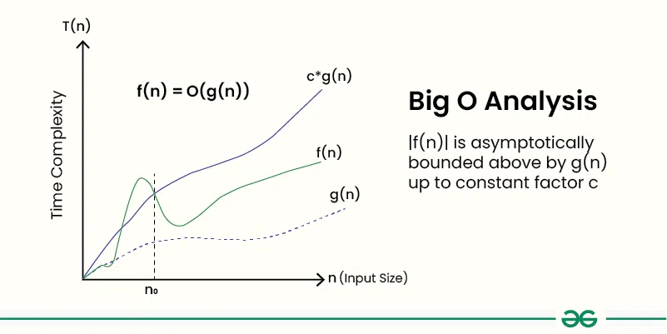
Big - Oh
Big O notation is a mathematical way to describe how the execution time or memory usage of an algorithm scales as the input size grows. It focuses on the worst-case scenario and ignores constant factors and minor details, measuring only the overall growth trend (as n → ∞)
Describes the asymptotic behaviour (order of growth of time or space in terms of input size) of a function, not its exact value.
Can be used to compare the efficiency of different algorithms or data structures.
It provides an upper limit on the time taken by an algorithm in terms of the size of the input. We mainly consider the worst case scenario of the algorithm to find its time complexity in terms of Big O

Slide 42
Categories of Algorithm
According to the Big O notation, we have five different categories of algorithms:
Constant time algorithm: running time complexity given as O(1)
Linear time algorithm: running time complexity given as O(n)
Logarithmic time algorithm: running time complexity given as O(log n)
Polynomial time algorithm: running time complexity given as O(nk) where k > 1
Exponential time algorithm: running time complexity given as O(n ^2)

Slide 43
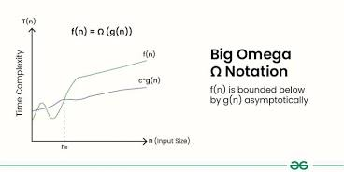
Omega Notation
Omega notation (Ω) describes the asymptotic lower bound of an algorithm's running time, representing the best-case performance scenario. It guarantees that for a sufficiently large input size n, an algorithm will take at least an amount of time proportional to g(n)
It analyses the best-case situation of the algorithm. It provides an equal or lower limit on the time taken by an algorithm in terms of the size of the input.
Definition : Given two functions g(n) and f(n), we say that f(n) = Ω(g(n)), if there exists constants c > 0 and n₀ >= 0 such that f(n) >= c*g(n) for all n >= n₀. In simpler terms, f(n) is Ω(g(n)) if f(n) will always grow faster than c*g(n) for all n >= n_{0,} where c and n₀ are constants.
We use it when we want to represent that the algorithm will take at least a certain amount of time or space.
For any algorithm, we can say that its time complexity is Ω(1) as it represents a constant value, and in this notation, we only have to guarantee a lower bound. However, it is always recommended to find as close to a lower bound as possible.

Slide 44
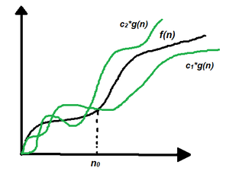
Theta Notation
Theta (Θ) notation is used in computer science to describe the exact asymptotic growth rate of an algorithm's time or space complexity. It represents a "tight bound," meaning the function is bounded both from above and below by constant multiples of a given formula for sufficiently large inputs
Theta Notation provides an exact bound on time or space complexity as it bounds a function from both upper and lower sides,
Compared to Big O or Big Omega, it gives more information in cases where we have an exact bound available and should be preferred.

Slide 45
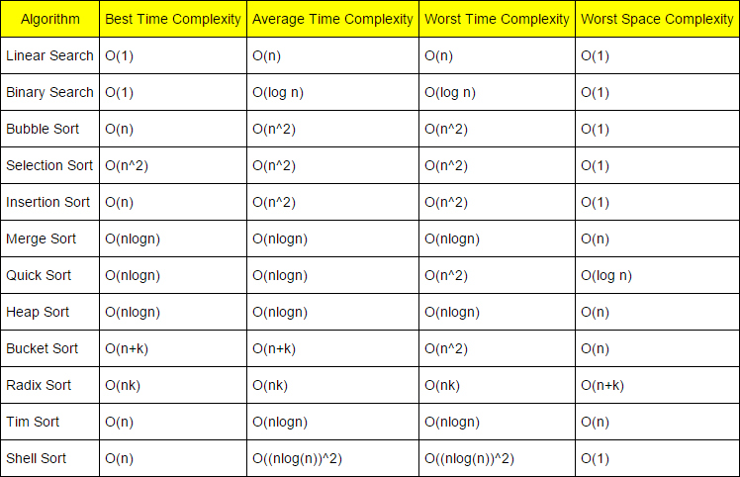
Complexities of various algorithms

Slide 46
String Functions
Common String Operations
Length: Calculates the total number of characters in a string.
Concatenation: Joins two or more strings together to form a new one.
Substring/Extraction: Retrieves a specific sequence of characters from within a larger string.
Case Conversion: Converts the text entirely to uppercase or lowercase.
Comparison: Checks if two strings are identical or determines their lexicographical (alphabetical) order.
Search/Find: Locates the position of a specific character or substring within a string.
Trim/Strip: Removes whitespace or specific characters from the beginning or end of a string

Slide 47
Bitwise Operators
Bitwise operators in C operate directly on the binary representation of integer values, performing operations bit by bit instead of on whole numbers. These operators are widely used in low-level programming, optimization, and embedded systems.
Work with integral data types like char, short, int, and long.
Used in system programming, embedded systems, and bit masking.
Help perform fast operations such as shifting, toggling, and checking bits.
Operator | Symbol | Description | Example
AND | & | Sets bit to 1 if both bits are 1 | a & b
OR | | | Sets bit to 1 if either bit is 1 | a | b
XOR | ^ | Sets bit to 1 if bits are different | a ^ b
NOT (Complement) | ~ | Inverts all bits | ~a
Left Shift | << | Shifts bits to the left | a << 2
Right Shift | >> | Shifts bits to the right | a >> 2

Slide 48
Bitwise Operators
Let: a = 5 → 00000101 b = 3 → 00000011
Operation | Binary Calculation | Result (Binary) | Result (Decimal)
a & b | 00000101 & 00000011 | 00000001 | 1
a | b | 00000101 | 00000011 | 00000111 | 7
a ^ b | 00000101 ^ 00000011 | 00000110 | 6
~a | ~00000101 | 11111010 (2's complement) | -6
a << 1 | 00000101 << 1 | 00001010 | 10
a >> 1 | 00000101 >> 1 | 00000010 | 2

Slide 49
Check
Q1. What is the primary purpose of a data structure?
A) To increase computer speed only B) To organize and store data efficiently C) To reduce the size of programs D) To write shorter code
Q2. Which of the following is an example of an Abstract Data Type (ADT)?
A) Array B) Linked List C) Stack D) Structure
Q3. Which of the following is a non-linear data structure?
A) Array B) Queue C) Linked List D) Tree
Q4. Which operation is used to visit each element of a data structure exactly once?
A) Insertion B) Traversing C) Deletion D) Searching
Q5. Which of the following control structures is commonly used for repeating a set of statements in an algorithm?
A) Selection B) Loop (Iteration) C) Function Call D) Declaration
Q6. Which time complexity represents the maximum time an algorithm may take for any input of size n?
A) Best Case B) Average Case C) Worst Case D) Amortized Case
Q7. Which string function returns the length of a string in C?
A) strcpy() B) strcmp() C) strlen() D) strcat()
Q8. Which bitwise operator is used to perform the AND operation?
A) | B) & C) ^ D) ~

Slide 50
Check
Q9. What is the result of the expression 5 << 1?
A) 2 B) 5 C) 10 D) 20
Q10. Which bitwise operator is used to toggle specific bits of a number?
A) & B) | C) ^ D) >>
Answer Key
B – To organize and store data efficiently
C – Stack
D – Tree
B – Traversing
B – Loop (Iteration)
C – Worst Case
C – strlen()
B – &
C – 10
C – ^

Slide 51
Check
A = 12 (1100)
B = 10 (1010)
Calculate
A & B
A | B
A ^ B
A << 1
A >> 1
1100 (12)
& 1010 (10)
---------
1000 (8)
1100 (12)
| 1010 (10)
---------
1110 (14)
1100 (12)
^ 1010 (10)
---------
0110 (6)
1100 (12)
<< 1
---------
11000 (24)
1100 (12)
>> 1
---------
0110 (6)

